Slide 1


A Machine Learning Based Parallelization Assistant
Aleksandr Maramzin, Christos Vasiladiotis, Roberto Castañeda Lozano,
Björn Franke, Murray Cole
The University of Edinburgh
United Kingdom
AI-SEPS 2019 workshop

Slide 2

A Machine Learning Based Parallelization Assistant
Aleksandr Maramzin, Christos Vasiladiotis, Roberto Castañeda Lozano,
Björn Franke, Murray Cole
The University of Edinburgh
United Kingdom
“It Looks Like You’re Writing a Parallel Loop”
AI-SEPS 2019 workshop

Slide 3
Presentation Structure
Problem statement
How to use the assistant tool
Assistant internals
Parallelization of SNU NPB benchmarks
AI-SEPS 2019 workshop

Slide 4
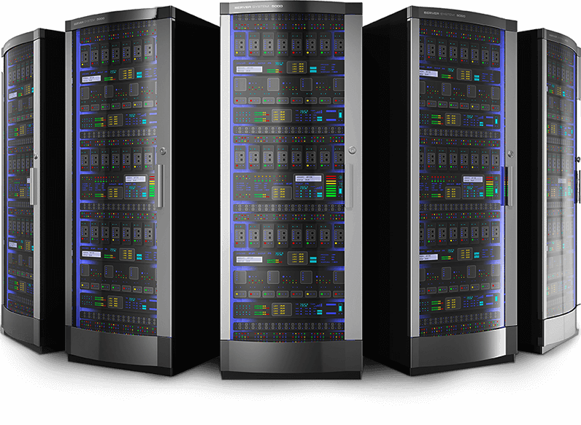
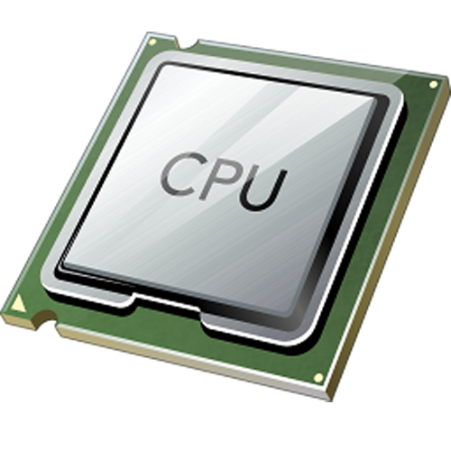
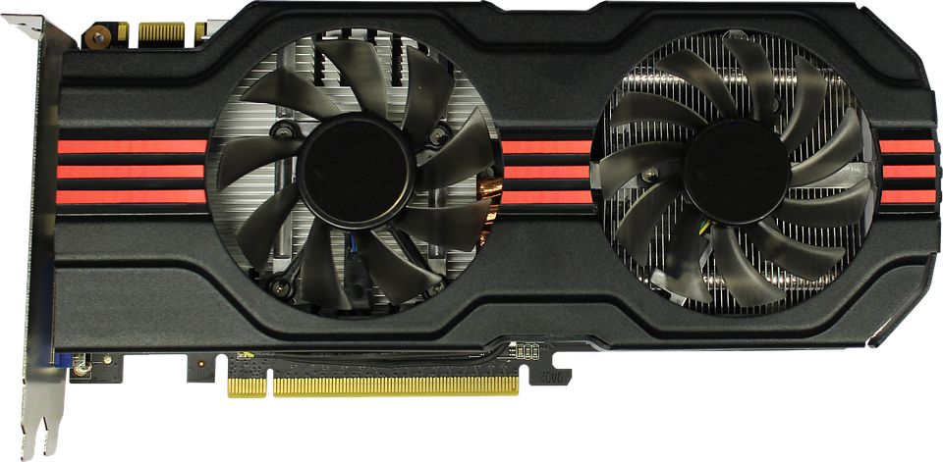


Problem Statement
Parallel Hardware
is Ubiqutous
Automatic Parallelization
is Limited
statement₁₁
statement₁₁
statement₁₁
statement₁₂
statement₁₂
...
statement₁₂
...
...
...
statement_{1n}
statement_{1n}
statement_{1n}
Software
is Sequential
Manual Parallelization
is Hard
statement₁
statement₂
...
statement_{n}
1

Slide 5
Problem Statement
Parallel Hardware
is Ubiqutous
Automatic Parallelization
is Limited
The assistant solution we propose alleviates
the process of manual parallelization
statement₁₁
statement₁₁
statement₁₁
statement₁₂
statement₁₂
...
statement₁₂
...
...
...
statement_{1n}
statement_{1n}
statement_{1n}
Manual Parallelization
is Hard
Software
is Sequential
statement₁
statement₂
...
statement_{n}
1

Slide 6



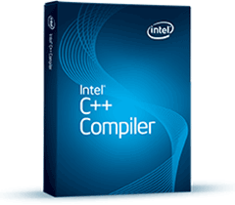
Problem Statement
NAS Parallel Benchmarks (NPB)
Parallelization Speedup
(Gmean)
Manual: 1.73x
Automatic: 0.79x - 1.10x
Programmer still plays the major role in the hard task of software parallelization
2

Slide 7
Manual Parallelization: Where Should I Start?
Source Code
L₀:
for (int i=0; … ) {
...
}
L₁:
for (int j=0; j<n;… ) {
...
}
...
L_{n}:
for (int m=0;… ) {
for (int k=m; k<n;… ) {
...
}
}
3

Slide 8
Manual Parallelization: Where Should I Start?
Source Code
L₀:
for (int i=0; … ) {
...
}
Where Should I Start?
L₁:
for (int j=0; j<n;… ) {
...
}
...
L_{n}:
for (int m=0;… ) {
for (int k=m; k<n;… ) {
...
}
}
3

Slide 9
Manual Parallelization: Where Should I Start?
Source Code
Program Loop Rankings
L₀:
for (int i=0; … ) {
...
}
Source Order
L₀, L₁, … , L_{n}
L₁:
for (int j=0; j<n;… ) {
...
}
...
L_{n}:
for (int m=0;… ) {
for (int k=m; k<n;… ) {
...
}
}
3

Slide 10

Manual Parallelization: Where Should I Start?
Source Code
Program Loop Rankings
L₀:
for (int i=0; … ) {
...
}
Source Order
L₀, L₁, … , L_{n}
L₁:
for (int j=0; j<n;… ) {
...
}
...
L_{n}:
for (int m=0;… ) {
for (int k=m; k<n;… ) {
...
}
}
3

Slide 11
Manual Parallelization: Where Should I Start?
Source Code
Program Loop Rankings
L₀:
for (int i=0; … ) {
...
}
Source Order
L₀, L₁, … , L_{n}
L₁:
for (int j=0; j<n;… ) {
...
}
...
L_{n}:
for (int m=0;… ) {
for (int k=m; k<n;… ) {
...
}
}
3

Slide 12
Manual Parallelization: Where Should I Start?
Source Code
Program Loop Rankings
L₀:
for (int i=0; … ) {
...
}
Source Order
L₀, L₁, … , L_{n}
L₁:
for (int j=0; j<n;… ) {
...
}
Traditional Empirical and
Experimental Method
Profile Order
L₁₇, L₁₂, … , L₁
...
L_{n}:
for (int m=0;… ) {
for (int k=m; k<n;… ) {
...
}
}
3

Slide 13
Manual Parallelization: Where Should I Start?
Source Code
Program Loop Rankings
L₀:
for (int i=0; … ) {
...
}
Source Order
L₀, L₁, … , L_{n}
L₁:
for (int j=0; j<n;… ) {
...
}
Traditional Empirical and
Experimental Method
Profile Order
L₁₇, L₁₂, … , L₁
...
L_{n}:
for (int m=0;… ) {
for (int k=m; k<n;… ) {
...
}
}
3

Slide 14
Manual Parallelization: Where Should I Start?
Source Code
Program Loop Rankings
L₀:
for (int i=0; … ) {
...
}
Source Order
L₀, L₁, … , L_{n}
L₁:
for (int j=0; j<n;… ) {
...
}
Traditional Empirical and
Experimental Method
Profile Order
L₁₇, L₁₂, … , L₁
...
Assistant Order
L₁₂, L₇, … , L₃
L_{n}:
for (int m=0;… ) {
for (int k=m; k<n;… ) {
...
}
}
AI-inspired Method
3

Slide 15
Manual Parallelization: Where Should I Start?
Source Code
Program Loop Rankings
L₀:
for (int i=0; … ) {
...
}
Source Order
L₀, L₁, … , L_{n}
L₁:
for (int j=0; j<n;… ) {
...
}
Traditional Empirical and
Experimental Method
Profile Order
L₁₇, L₁₂, … , L₁
...
Assistant Order
L₁₂, L₇, … , L₃
L_{n}:
for (int m=0;… ) {
for (int k=m; k<n;… ) {
...
}
}
AI-inspired Method
3

Slide 16
Manual Parallelization: Where Should I Start?
Source Code
Program Loop Rankings
L₀:
for (int i=0; … ) {
...
}
Final Programmer
Decision
Source Order
L₀, L₁, … , L_{n}
L₁:
for (int j=0; j<n;… ) {
...
}
Traditional Empirical and
Experimental Method
Profile Order
L₁₇, L₁₂, … , L₁
...
Assistant Order
L₁₂, L₇, … , L₃
L_{n}:
for (int m=0;… ) {
for (int k=m; k<n;… ) {
...
}
}
AI-inspired Method
3

Slide 17

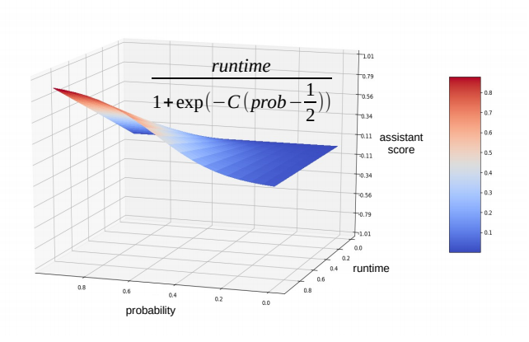
Proposed Solution (ML based software parallelization assistant)
Tool
Methodology
&
AI-SEPS 2019 workshop

Slide 18
Assistant Training
4

Slide 19
Assistant Training
SNU NPB
1415 loops
4

Slide 20
Assistant Training
Training Data Set
Parallelizable loops
for (int i=...) { … }
[ f₁,f₂,…,f_{n} ]
SNU NPB
…
for (int j=...) { … }
[ f₁,f₂,…,f_{n} ]
995 loops
Non-parallelizable loops
while (true) { … }
[ f₁,f₂,…,f_{n} ]
…
1415 loops
for (int k=...) { … }
[ f₁,f₂,…,f_{n} ]
420 loops
4

Slide 21
Assistant Training
Training Data Set
Parallelizable loops
for (int i=...) { … }
[ f₁,f₂,…,f_{n} ]
SNU NPB
…
ML Based
Loop Parallelizability Model
for (int j=...) { … }
[ f₁,f₂,…,f_{n} ]
995 loops
Non-parallelizable loops
while (true) { … }
[ f₁,f₂,…,f_{n} ]
…
1415 loops
for (int k=...) { … }
[ f₁,f₂,…,f_{n} ]
420 loops
4

Slide 22
Assistant Training
Training Data Set
Parallelizable loops
for (int i=...) { … }
[ f₁,f₂,…,f_{n} ]
SNU NPB
…
ML Based
Loop Parallelizability Model
for (int j=...) { … }
[ f₁,f₂,…,f_{n} ]
995 loops
Loop Parallelizability Probability
Non-parallelizable loops
while (true) { … }
[ f₁,f₂,…,f_{n} ]
…
1415 loops
for (int k=...) { … }
[ f₁,f₂,…,f_{n} ]
420 loops
4

Slide 23
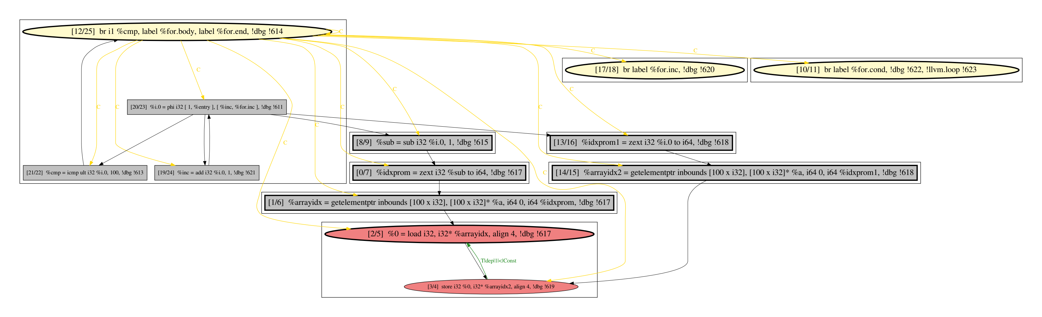

Loop Features [74]
Loop Iterator
Loop Iterator
Loop Critical Payload
Loop features are based on static structural properties of loop program dependence graphs (PDGs):
Absolute size
Loop Iterator/Payload cohesion
Number of dependence edges
Instruction types (calls, loads/stores, etc.)
etc.
5

Slide 24
Loop Ranking Score
ML Based
Loop Parallelizability Model
6

Slide 25
Loop Ranking Score
ML Based
Loop Parallelizability Model
Not Aware of Loop
Running Time
6

Slide 26
Loop Ranking Score
Profiler
ML Based
Loop Parallelizability Model
Not Aware of Loop
Running Time
6

Slide 27
Loop Ranking Score
Profiler
Not Aware of Loop
Parallelizability
ML Based
Loop Parallelizability Model
Not Aware of Loop
Running Time
6

Slide 28
Loop Ranking Score
Profiler
Not Aware of Loop
Parallelizability
ML Based
Loop Parallelizability Model
Programmer Effort
Not Aware of Loop
Running Time
6

Slide 29
Loop Ranking Score
Profiler
Performance Gain
Not Aware of Loop
Parallelizability
ML Based
Loop Parallelizability Model
Programmer Effort
Not Aware of Loop
Running Time
6

Slide 30
Loop Ranking Score
Profiler
Performance Gain
Aware of Loop
Parallelizability
Not Aware of Loop
Parallelizability
ML Based
Loop Parallelizability Model
Aware of Loop
Running Time
Programmer Effort
Not Aware of Loop
Running Time
6

Slide 31
Loop Ranking Score
Profiler
Performance Gain
Aware of Loop
Parallelizability
Not Aware of Loop
Parallelizability
Improved Loop
Ranking
ML Based
Loop Parallelizability Model
Aware of Loop
Running Time
Programmer Effort
Not Aware of Loop
Running Time
6

Slide 32
Results
Deployment of our assistant on SNU NPB benchmarks
Predictive performance of our ML based loop parallelizability model
AI-SEPS 2019 workshop

Slide 33
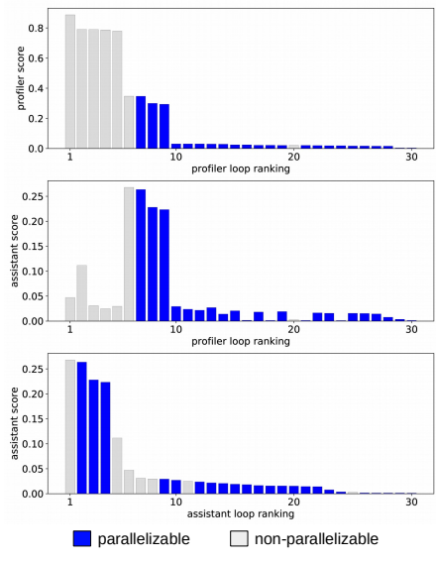
Loop Rankings: Profiler vs. Assistant
FT benchmark
7

Slide 34
Loop Rankings: Profiler vs. Assistant
FT benchmark
Profiler Loop
Ranking
7

Slide 35
Loop Rankings: Profiler vs. Assistant
FT benchmark
Profiler Loop
Ranking
Transformation
7

Slide 36
Loop Rankings: Profiler vs. Assistant
FT benchmark
Profiler Loop
Ranking
Transformation
Improved Loop
Ranking
7

Slide 37
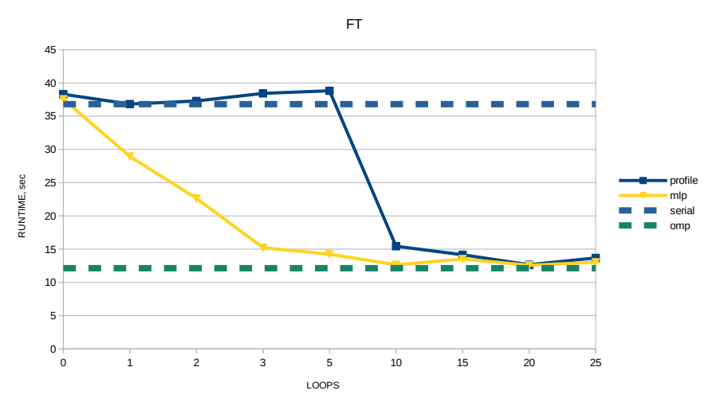
How well do we do?
8

Slide 38
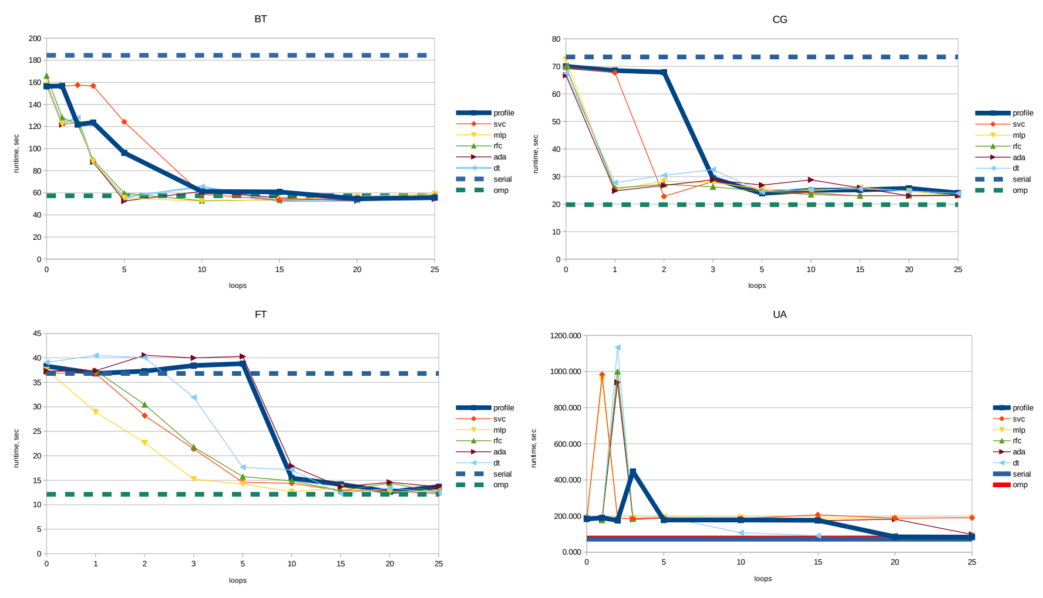
How well do we do?
9

Slide 39
How well do we do?
8 benchmarks in total: 4 wins / 4 draws
9

Slide 40
How well do we do?
Our methodology reduces the number of Lines Of Code (LOCs) to be manually inspected and transformed by 20%
That reduction might result into significant cost savings given a high price of a human expert
9

Slide 41
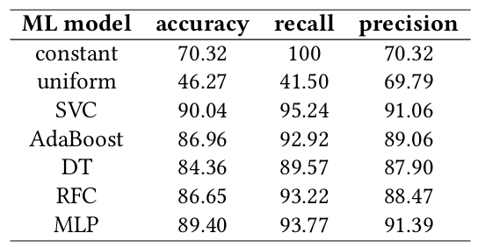
ML Model Predictive Performance
Reference
Around 90% predictive accuracy
10

Slide 42
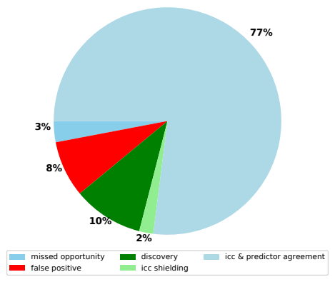
ML Model Predictive Performance
ML Based
Loop Parallelizability Model
Agreement rate of 80%
False positive rate of 8%
is not critical
Discovery rate of 10%
11

Slide 43
Summary & Conclusions
AI-inspired tool and methodology for manual software parallelization have been designed and implemented as a prototype:
Loop parallelizability is learnable property
Designed ML model of loop parallelizability achieves the accuracy of 90%
The model has been integrated into parallelization assistant
Deployed against SNU NPB benchmarks our assistant showed a faster parallelization process over traditional profile-guided method: a programmer is required to inspect and transform 20% less Lines Of Code (LOC)

Slide 44
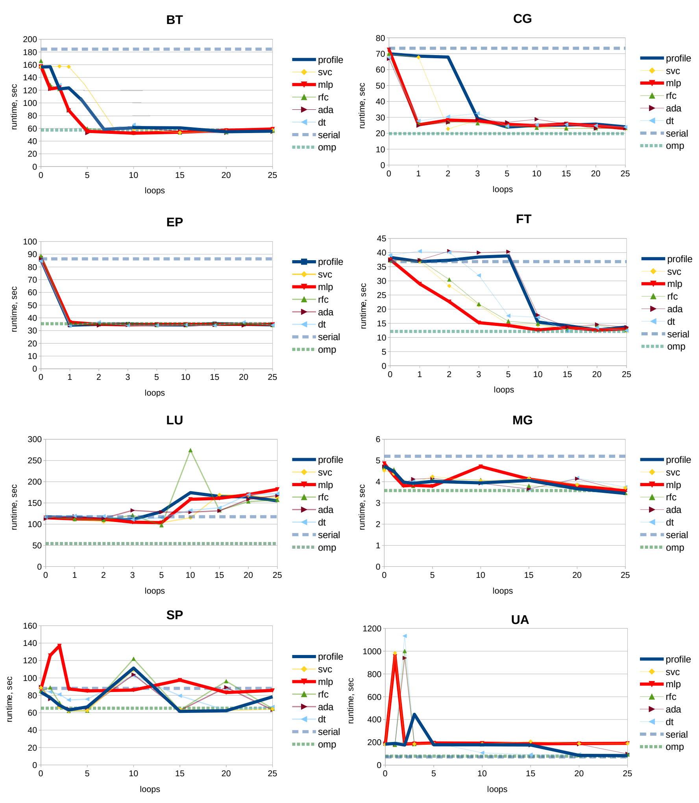
How well do we do?

Slide 45
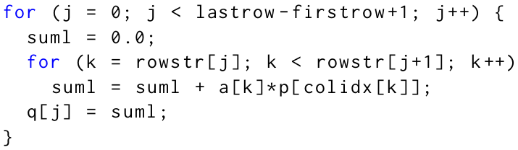
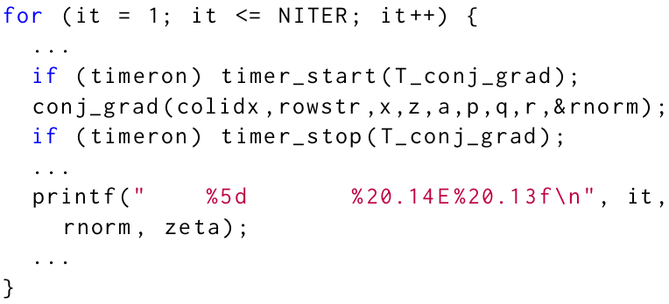
Motivating example
SNU NPB
Conjugate Gradient (CG)
benchmark
Profiler’s Loop Ranking
Assistant’s Loop Ranking
Assistant’s Parallel Loop
Probability
1
cg.c:326
vs.
1
cg.c:509
[ 85% ]
2
cg.c:484
2
cg.c:326
[ 29% ]
3
cg.c:509
3
cg.c:484
[ 8% ]
Profiler
Program Loop Ranking
...
cg.c:509
1
2
3
n
C/C++
program
ML Based
Loop Parallelizability Model
1
2
3
...
n
cg.c:326

Slide 46
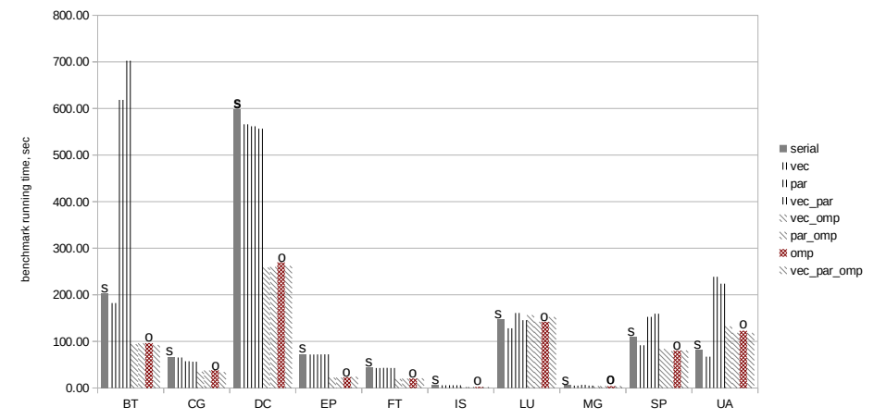
Problem Statement 2/2
NAS Parallel Benchmarks (NPB)

Slide 47
Problem Statement 2/2
NAS Parallel Benchmarks (NPB)
Programmer still plays the major role in the task of software parallelization

Slide 48
How to use the assistant
(from the programmers perspective)
Profiler
Ordered by the running time
...
1
2
3
n
Traditional Empirical and
Experimental Method
Final Programmer
Decision
C/C++
program
Program Loop Rankings
ML Based
Loop Parallelizability Model
Ordered by the assistant’s score
1
2
3
...
n
AI-inspired Method

Slide 49
Solution Scheme [1/2]
SNU NPB
Training Data Set
Loop Labels
Parallelizable loops
ML Based
Loop Parallelizability Model
for (int i=...) { … }
[ f₁,f₂,…,f_{n} ]
…
for (int j=...) { … }
[ f₁,f₂,…,f_{n} ]
995 loops *
1415 loops
Loop Features
Non-parallelizable loops
while (true) { … }
[ f₁,f₂,…,f_{n} ]
…
for (int k=...) { … }
[ f₁,f₂,…,f_{n} ]
420 loops
* Intel Compiler succeeds in parallelizing 812 loops
Loop features are based on static structural properties of loop program dependence graphs (PDGs):
Absolute size
Loop Iterator/Payload cohesion
Number of dependence edges
Instruction types (calls, loads/stores, etc.)
Loop labels are derived out of OpenMP pragmas present in parallelized SNU NPB versions as well as from the Intel Compiler’s parallelization/vectorization reports.

Slide 50
How well do we do?
No change in
4 other benchmarks
Improvement in
4 benchmarks

Slide 51
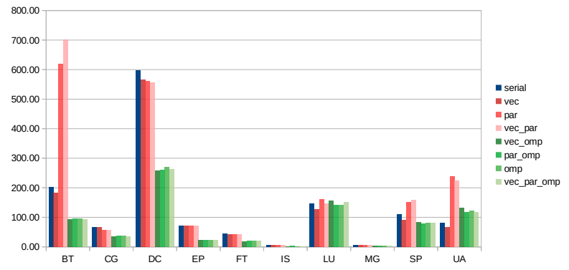
Problem Statement
NAS Parallel Benchmarks (NPB)
Speedup (Gmean)
OpenMP/Serial: 1.73x
Vector/Serial: 1.10x
Parallel/Serial: 0.79x
3

Slide 52
Loop Features [74]
Loop Iterator
Loop Iterator
Feature | Importance
payload call fraction | 23.5
iter/payload non-cf cohesion | 18.5
payload mem write fraction | 6.1
loop absolute size | 5.7
critical payload ptr access count | 5.3
payload memory dependence count | 4.0
critical payload non-cf cohesion | 2.9
payload ptr access fraction | 2.7
Loop Critical Payload
Loop features are based on static structural properties of loop program depencence graphs (PDGs):
Absolute size
Loop Iterator/Payload cohesion
Number of dependence edges
Instruction types (calls, loads/stores, etc.)
etc.
5

Slide 53
Assistant Training
Training Data Set
Parallelizable loops
for (int i=...) { … }
[ f₁,f₂,…,f_{n} ]
SNU NPB
…
ML Based
Loop Parallelizability Model
for (int j=...) { … }
[ f₁,f₂,…,f_{n} ]
995 loops *
Loop Parallelizability Probability
Non-parallelizable loops
while (true) { … }
[ f₁,f₂,…,f_{n} ]
…
1415 loops
for (int k=...) { … }
[ f₁,f₂,…,f_{n} ]
420 loops
* Intel Compiler succeeds in parallelizing 812 loops
4

